Slide 1
Neuroevolution in Games: State of the Art and Open Challenges
Govardhan Padmanabhan
WID170715
17069496/1

Slide 2
Introduction

Slide 3
Neuroevolution
Neuroevolution refers to the generation of artificial neural networks (ANN) using evolutionary algorithms (a class of stochastic, population-based search methods), motivated by the evolution of biological nervous systems.
This technique has been successfully used for various tasks like robot control, music generation, chip resource allocation, etc.
Main Motivations
Neuroevolution is a popular approach that has seen continued popularity.
Numerous existing applications in games, and even more potential applications.
Games are excellent testbeds for AI research (including neuroevolution)

Slide 4
Neuroevolution

Slide 5
Overview of NE
NE is motivated by the evolution of biological nervous systems and applies evolutionary algorithms to generate ANNs.
ANNs are represented as networks composed of interconnected nodes (neurons) that can compute values based on external inputs provided to the network.
ANNs’ behavior are typically determined by the architecture of the network and the weights of the connections between the neurons.
The genetic reprsentation (genotype) of the neural network is an important design choice in NE.
Basic Algorithm
A population of genotypes, that encode ANNs, is evolved to find a network that can solve a computational problem
The performance (fitness) of this network is recorded.
After the fitness value is determined for all genotypes in the current population, a new population is formed by slightly changing the genotypes (mutating) or combining multiple genotypes (cross-over).
Genotypes with higher fitness values have higher chance of reproduction
Their offsprings replaces genotypes with lower fitness values
This loop is repeated thousands of times to find better performing networks

Slide 6
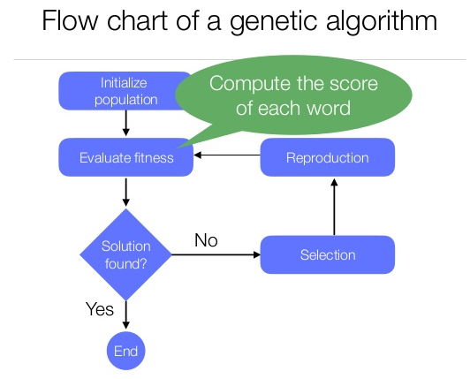

Slide 7
Why Neuroevolution?
Record- Beating Performance
NE provides the best performance in competition with other learning methods
Broad Applicability
NE can be used for supervised, unsupervised and reinforcement learning tasks
Scalability
NE can handle large action/states spaces
Diversity
NE can draw from diversity-preservation methods (such as niching) and multi-objective methods
Open-ended learning
In principle, NE can support open-ended evolution where behaviour of arbitrary complexity and sophistication could emerge
Enables new kinds of games
New and unique video games (e.g. Petalz, Creatures) has been made possible with NE, because NE supports continuous complexification of produced content.
Adaptive ANNs facilitate open-ended learning by incorporating exploration.

Slide 8
Why Not Neuroevolution?
Evolved neural networks tend to have a “black box” characteristics:
Humans cannot easily work out what they are doing by looking at them
Becomes difficult to debug their learnt behaviours
Hard to predict what kind of behaviour is actually being learnt by it online

Slide 9
Role of Neuroevolution

Slide 10
According to the literature review in the paper, most cases use NE to learn to play a game or control an NPC in the game.
Use of NE in Games
State/Action Evaluation
To evaluate the values of states or actions, so that some other algorithm can decide which action to take
Direct Action Selection
Directly select the actions to take in each state
Selection Between Strategies
Choose between one of several strategies to be played for a duration
Modelling Opponent Strategy
To predict the opponent’s strategy
Content Generation
To create levels/parts of games algorithmically
Modelling Player Experience
To use previous player experiences to make predictions

Slide 11
Neural Network Types

Slide 12
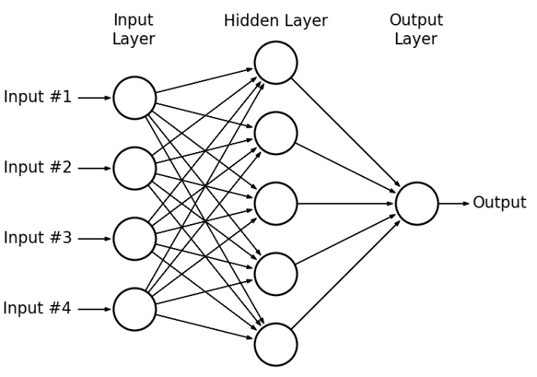
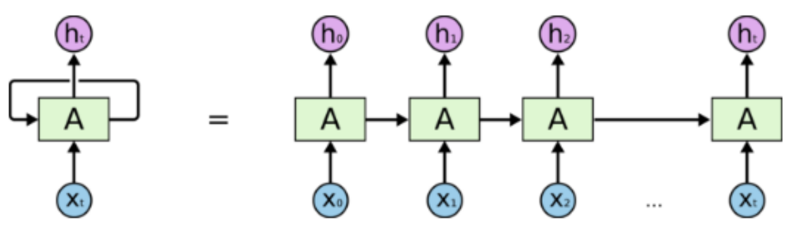
1.) Feed Forward Networks
The simplest neural network, the information travels directly from the input nodes through the hidden nodes to the output nodes.
There are no synaptic connections that forms cycles or loops.
A simple version is the perceptron, which is an ANN with no hidden nodes.
Can only solve linearly separable problems.
A complex version is the multilayer perceptron, which contains multiple hidden nodes.
Can learn to solve more complex problems.
2.) Recurrent Networks
Recurrent neural networks (RNN) can form loops and cycles
Allows information to be propagated from later layers back to earlier layers
Recurrent networks can have memory

Slide 13
3.) Modular Networks
Composed of number of individual neural networks (modules), each of which are responsible for a specific sub-function of the overall system
Easier to evolve multimodal behavior with modular architectures
4.) Plastic Networks
Plastic neural networks can change their connection weights at any time based on the activation pattern of the network
This enables a form of longer-term learning
Have been evolved to solve robot tasks in unpredictable environments, but not yet applied to games
5.) Long-Short Term Memory (LSTM)
A version of RNNs that can learn by remembering values for an arbitrary amount of time, without having to change weights.

Slide 14
Evolving Neural Networks

Slide 15
1.) Fixed Topology
Only evolved the weights of a network with a fixed user-defined topology
This allows to represent the whole network as a vector of real numbers
Allows the use of any evolutionary algorithms which work on vectors
The significant drawback is that the user must choose the appropriate topology and number of hidden nodes beforehand
2.) Topology-Evolving Approach
Evolve the topology together with the weights (for example, NeuroEvolution of Augmenting Topologies)
Increased performance in strategic-decision making tasks
A drawback is that parts of the solution that are similar have to be discovered separately through mutation
Direct encoding in fixed-topology and topology-evolving approaches means that each connection is encoded separately as a real number, while indirect encodings allow the reuse of information to encode the final network and this very compact genetic representation.

Slide 16
Input Representation

Slide 17
Choosing the right representation can significantly influence the ability of an algorithm to learn autonomously.
Especially important when controlling an NPC.
Appropriate representation depends on the type and the role of the neural network in controlling the agent.
Different Types of Input Representation
Straight Line Sensors and Pie Slice Sensors
Egocentric first-person information from rangefinder sensors, which returns the distance to the nearest object in a given direction.
“Pie Slice” sensors were for detecting and calculating distance from enemies (or any discrete object)
Angle Sensors and Relative Position Sensors
Egocentric angle sensor, which simply reports the angle to a particular object or the nearest of some class of object
Pathfinding Sensors
Does not consider the orientation of controlled agent, but instead takes the topology of the environment into consideration
Reports the distance to the closest of some type of entity along the shortest path (e.g. A*)
Commonly used in 2D games
Third-Person Input
Inputs beyond the first-person sensors that are not tied to a specific frame of reference
Learning from Raw Sensory Data
Learning from raw sensory data helps in understanding important aspects of a game’s visual space, and forces games to rely on the same information as a human player gets
Enables more general game playing skills (human-like agent behavior) to develop

Slide 18
Open Challenges

Slide 19
Reaching record-beating performance
Comparing and combining evolution with other learning methods
Learning from high-dimensional / raw data
General video game playing
Combining NE with life long learning
Competitive and cooperative coevolution
Fast and reliable methods for commercial games

Slide 20
Thank You

